Slide 1


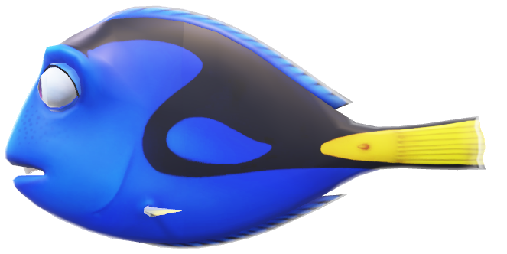
Ocean Gardens

Slide 2



Ocean Gardens
Hello buds!!! Dory this side.
Welcome to my home OCEAN.
What’s up NEMO?

Slide 3
Ocean Gardens
HEY! Welcome to "The Hidden Wonders of the Ocean," where we take you on a mesmerizing journey to discover the crucial role the ocean plays in sustaining life on Earth.

Slide 4
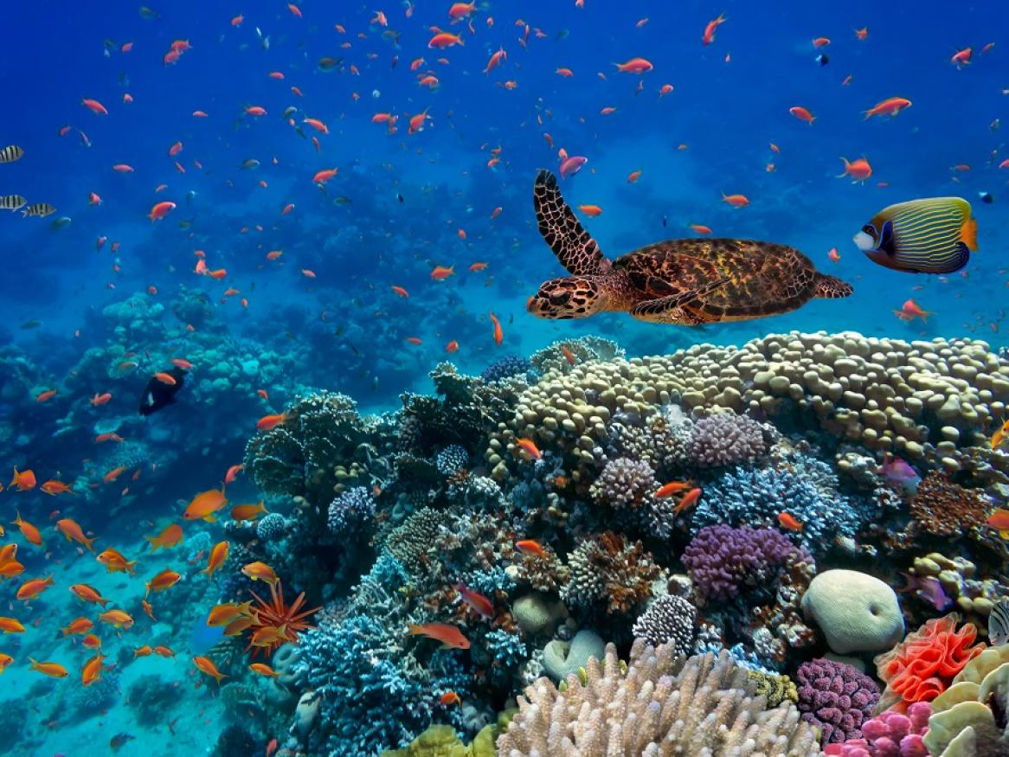

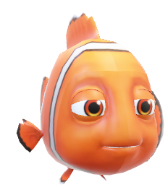
Imagine you visit a landlocked region where none of the inhabitants have ever been to the ocean. Although they may not be aware of it, every single day these people breathe oxygen generated by marine photosynthesis, benefit from the lowered atmospheric carbon dioxide (CO2) levels induced by marine phytoplankton, and consume food that was fueled by marine ecosystems.

Slide 5
In essence, the ocean can be viewed as a garden that provides beauty, resources, and CO2 drawdown for society.

Slide 6

Carbon dioxide (CO2) drawdown is nature's way of using trees, plants, and the ocean to remove CO2 from the air, combating global warming.

Slide 7
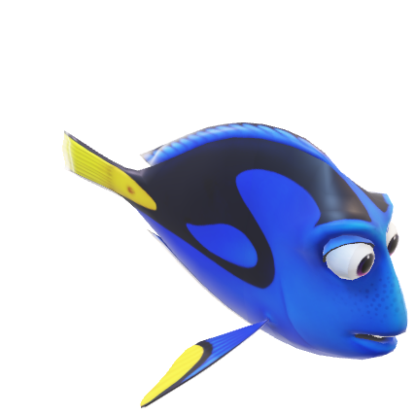

Did you know that the ocean makes up 70% of Earth by area and up to 90-95% of the volume of Earth that is habitable for life

Slide 8

Did you know that the ocean makes up 70% of Earth by area and up to 90-95% of the volume of Earth that is habitable for life

Slide 9
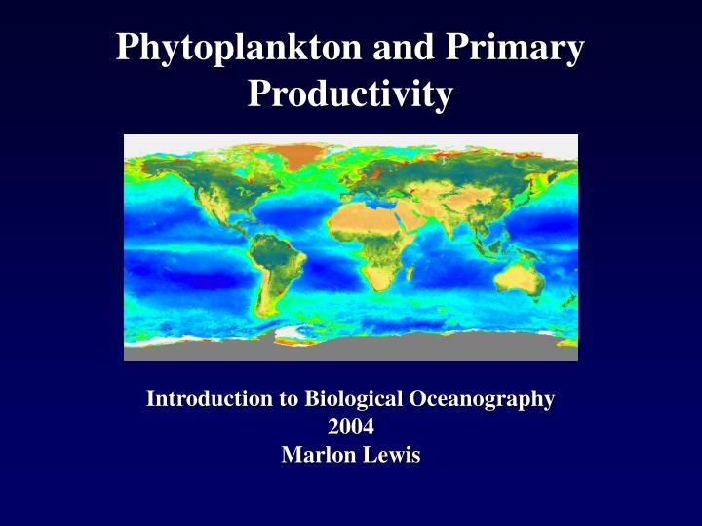
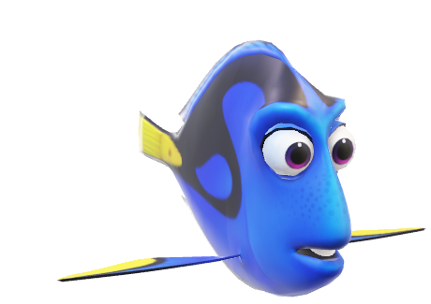

Impressively, half of all net primary production, which is the rate of new biomass on Earth, comes from marine phytoplankton.

Slide 10
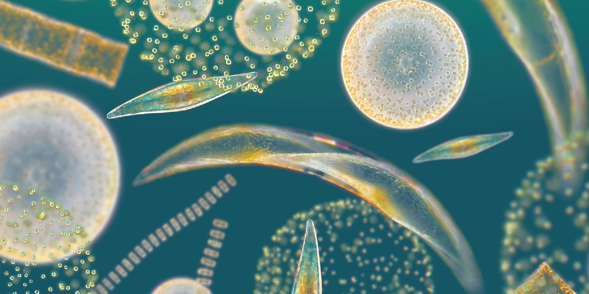

These tiny, unicellular organisms perform photosynthesis, forming the base of the entire ocean ecosystem

Slide 11
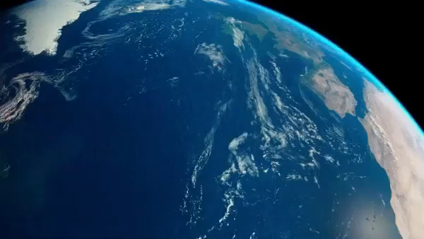

Slide 12
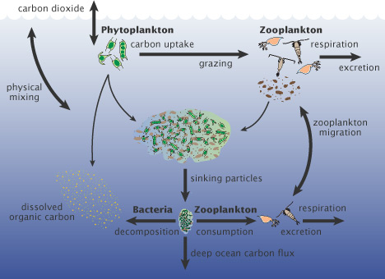

Not only do marine phytoplankton provide food for other animals in the sea and oxygen for us to breathe, but they also play a crucial role in absorbing carbon dioxide from the atmosphere and enabling carbon sequestration.

Slide 13
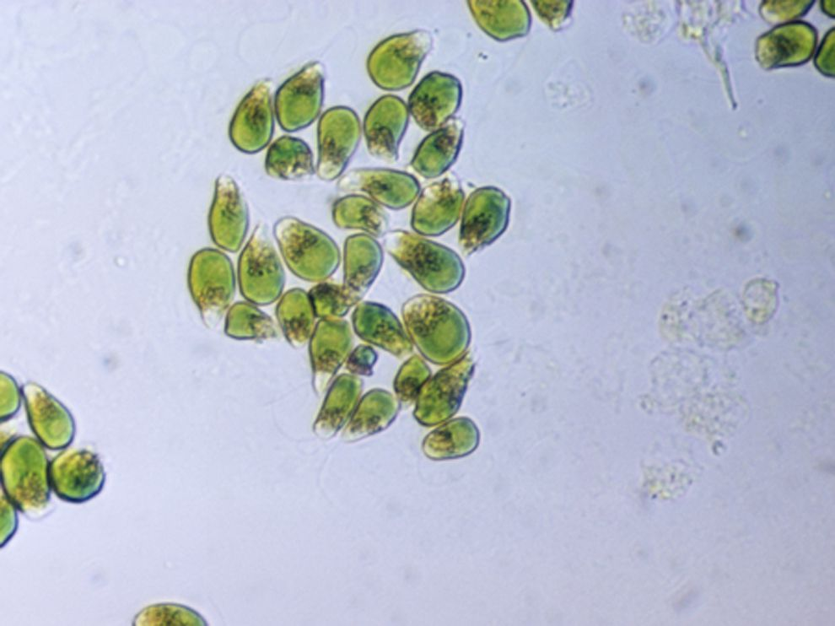
In fact, current efforts show that phytoplankton remove between 5-12 gigatons of carbon dioxide per year

Slide 14
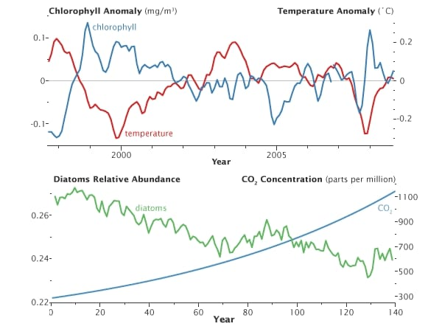
To limit global warming to 1.5 degrees Celsius, we need to remove approximately 100-1000 gigatons of carbon dioxide from 2000-2100."

Slide 15
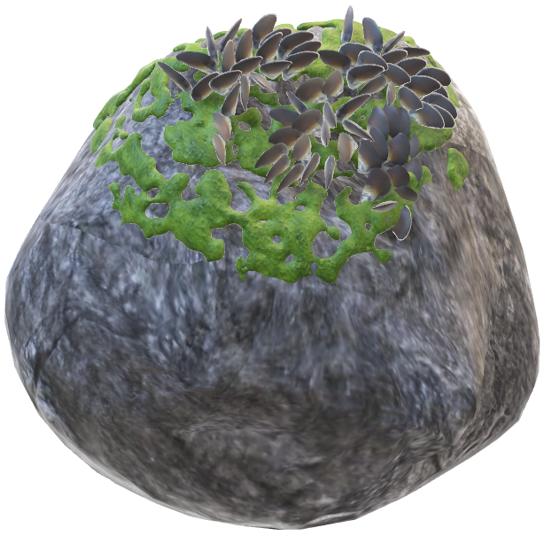

But how can we enhance these rates?
Can science help us bolster the capabilities of marine ecosystems?

Slide 16
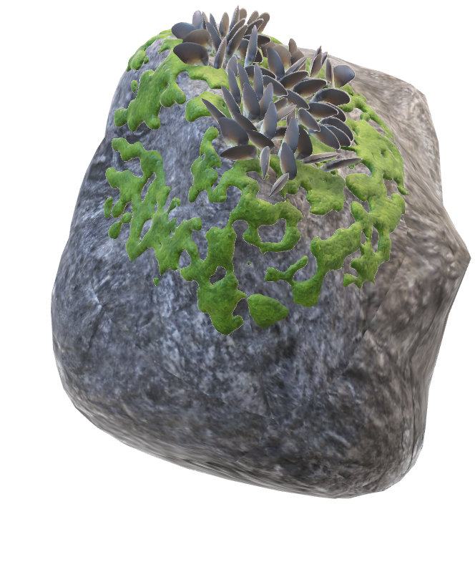
As climate change, conflict, and disease exacerbate food and energy insecurities, ocean-based solutions such as deep seabed mining have been suggested to support the shift to renewable energy and increase the food supply

Slide 17


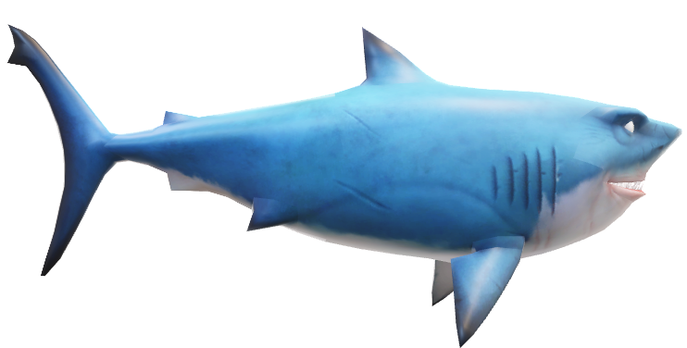
So, how can we make ocean science more accessible and translatable to others?

Slide 18

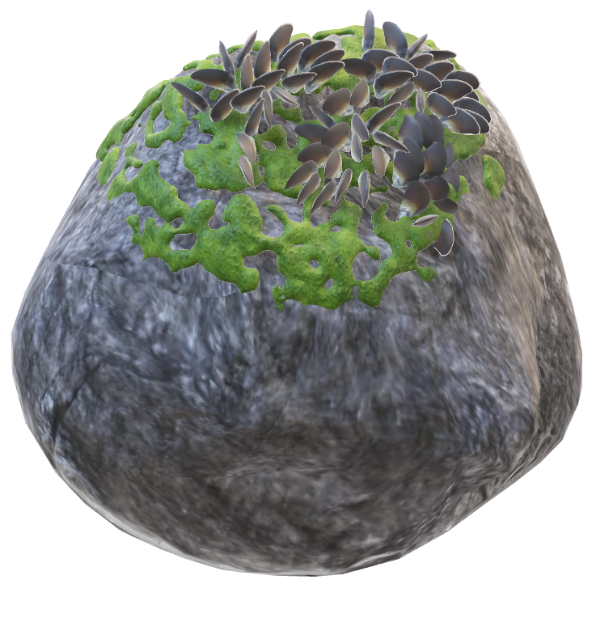
Let's unlock the hidden wonders of the ocean, instilling a deeper appreciation for its role in sustaining life on Earth and fostering a collective responsibility towards its preservation

Slide 19




THANK YOU

